Slide 1
Getters & Setters

Slide 2
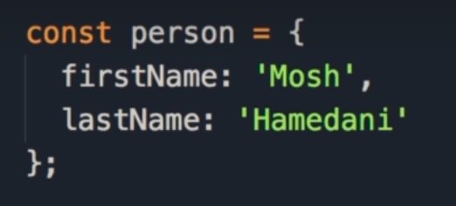
Getters & Setters
In this lecture, we are going to look at 2 special methods in objects, called getters and setters.
We start by initializing a person object with 2 properties: firstName & lastName.
Notes:
In this lecture, we're going to look at a special kind of methods in objects called getters and setters.
So let's imagine we have the person object with two properties.
First name, set this to Mosh, and last name, set this to Hamedani.

Slide 3

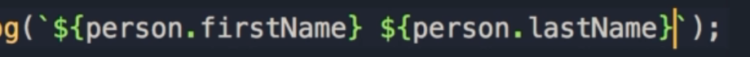
Displaying full name
Now we want to display a person’s full name.
We can either log the person.firstName, concatenate it with a space, then add person.lastName, or we could use template literals.
In between backticks, we have 2 arguments, the first is person.firstName, and the second is person.lastName
The problem with this approach is maybe there are multiple places in our application where we want to display someone's full name.
With the current implementation, we'll have to repeat this template literal in multiple places.
Notes:
Now somewhere in our application we want to display a person's full name.
So, we have to do something like this. Console.log we can either get the person.firstName, concatenate it with space and the last name, or a better way, as I told you before, is to use a template literal.
So we use the back tick and then we add a couple arguments here, so, here's the first one, the argument is person.firstname, now we have a space, and here's the second argument, person.lastname, however, the problem with this approach is maybe there are multiple places in our application where we want to display someone's full name.
With the current implementation, we'll have to repeat this template literal in multiple places.

Slide 4
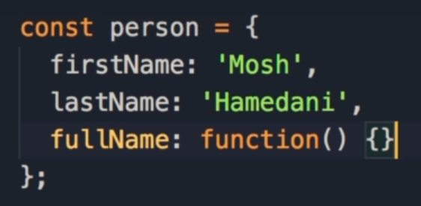
Creating the method
A better approach is to define a method in the object, call it fullName, and move this expression in there.
And then whenever we want to display a person's full name we simply call that person's method.
Here we start with a key-value pair: fullName which we set to a function.
Notes:
A better approach is to define a method in this object, call it full name, and move this expression right there.
And then whenever we want to display a person's full name we simply call that person's method.
So, we can add another key value pair, full name, but we set the value to a function,

Slide 5
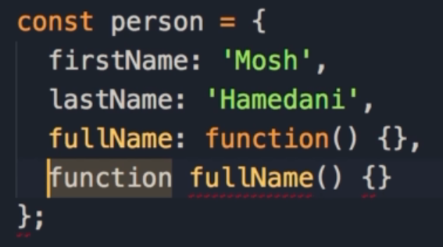
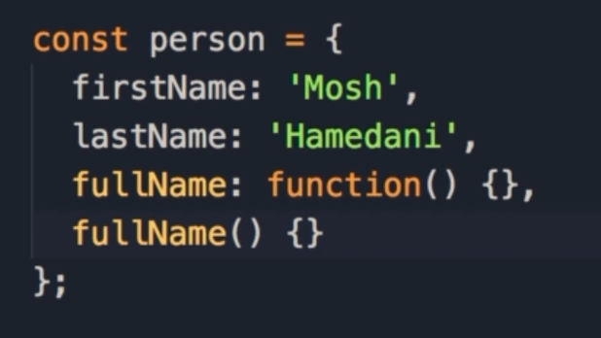
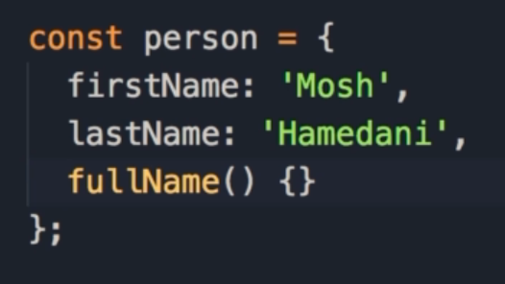
Shortening the syntax
As we have learn before, we have a shorter syntax to add a method to a function.
To define a function outside of an object, we use the function keyword, give the function a name followed by parentheses and curly braces.
When we need to add this inside of an object, we just drop the function keyword.
So you can see, this new syntax is shorter and cleaner than the older syntax.
Notes:
or as I told you before, in ES6 we have a shorter syntax, to add a method to an object so instead of adding it as a key value pair, we can add it as a function without the function keyword.
So, if you want to define a function outside of an object, what do we do?
We add function, the name of the function, parenthesis, and curly braces.
However, when we need to add this inside of an object, we just drop the function keyword.
So you can see, this new syntax is shorter and cleaner than the older syntax, okay?

Slide 6

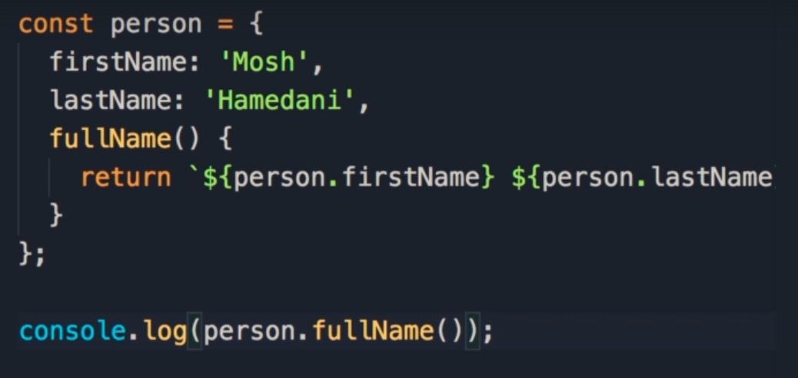
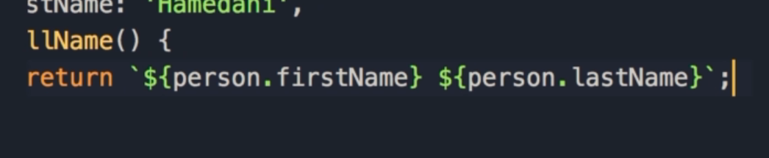

Here is the fullName method, which returns firstName and lastName.
Any time we want to access the full name, we simply call person.fullName()
In our console, we see the full name printed out.
There are a few problems with this approach however.
Notes:
So here's our full name method, we simply return this expression here.
So I'm going to cut this, and move it here.
Now with this new implementation, every time we need to display someone's full name, we simply call person.fullname.
Save the changes, we get Mosh Hamedani.
Beautiful. However, there are a couple problems.
With this approach.

Slide 7

Read Only
The first problem, is that this is read only.
In other words, we cannot change the full name by assigning it using dot notation.
It will be nice if we could do this, and then the first name and last name properties would be automatically set based on what we passed here.
Notes:
The first problem, is that this is read only.
In other words, we cannot set a person's full name from the outside.
It will be nice if we could do this, and then the first name and last name properties would be automatically set based on what we passed here.

Slide 8


Calling a method
The other issue, is that we would prefer to call it like a property, not a method.
Basically, to remove the parentheses.
How do we deal with this?
This is where getters and setters come into play.
Notes:
The other issue is that I don't like to call this like a method.
It would be nicer, if we could treat this as a property.
So, we could drop the parenthesis.
Like this.
So how do we do this? Well, that's where getters and setters come in the picture.

Slide 9
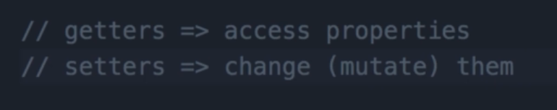
Getters and Setters
We use getters to access properties in an object, and setters to change or mutate them.
In this object we should add a getter, and with that getter we can read this person's full name, like a property, and with a setter we can set it from the outside.
Notes:
We're use getters to access properties in an object and setters to change or mutate them.
So in this object we should add a getter, and with that getter we can read this person's full name, like a property, and with a setter we can set it from the outside.

Slide 10
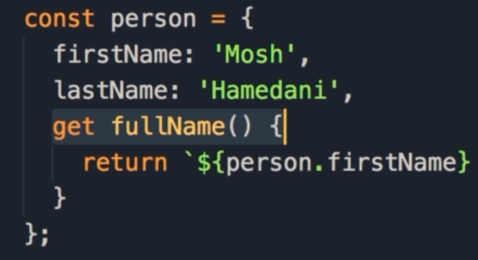
Getters
This is how it works:
We prefix out method with the get keyword.
Now this method is a getter.
This means we can access fullName like a property.
In order to set the fullName from outside the object, we need a setter.
Notes:
So here is how it works.
We prefix this method with the get keyword, and now this method is a getter.
So we can access the full name like a property on line 15.
Save the changes, you can see our program is still working, beautiful, so this is our getter, now to be able to set this from the outside we need to add a setter.

Slide 11
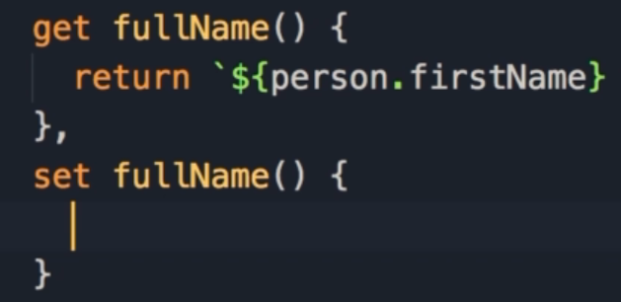
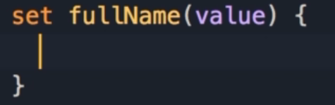
Setters
A setter is very similar.
We use the set keyword, followed by the name of the property or method, followed by a code block.
However, this method need a parameter, which we will call value.
The value of this parameter is what we have on the right side of the assignment operator when calling the setter.
Notes:
A setter is very similar.
So we add the set keyword, the name of the property or method, and then code block.
However, this method needs a parameter, you can call it value or anything.
And the value of this parameter will be what we have in the right side of the assignment operator.

Slide 12
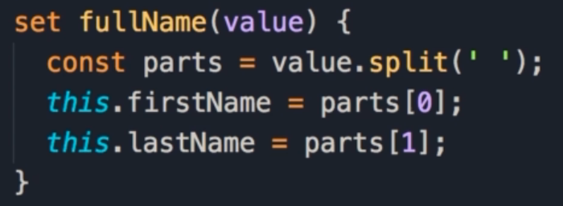
The set method
Let’s assume that value is a valid string: we need to split that string by a blank space, take the parts and set firstName and lastName properties.
We start by calling the split method of strings on the value we pass in, and separate these by blank spaces.
The split method returns an array, so we store that in a variable called parts.
Now we set firstName to the first item in the array, and lastName to the second item in the array.
Notes:
So here let's assume that value is a valid string, we need to split that string by a space, take the parts and set the first name and last name properties.
So, value call the split method of string, you want to split it by a space, this will return array, we can call that parts.
Now we can set the first name to parts of 0, and last name to parts of 1.

Slide 13
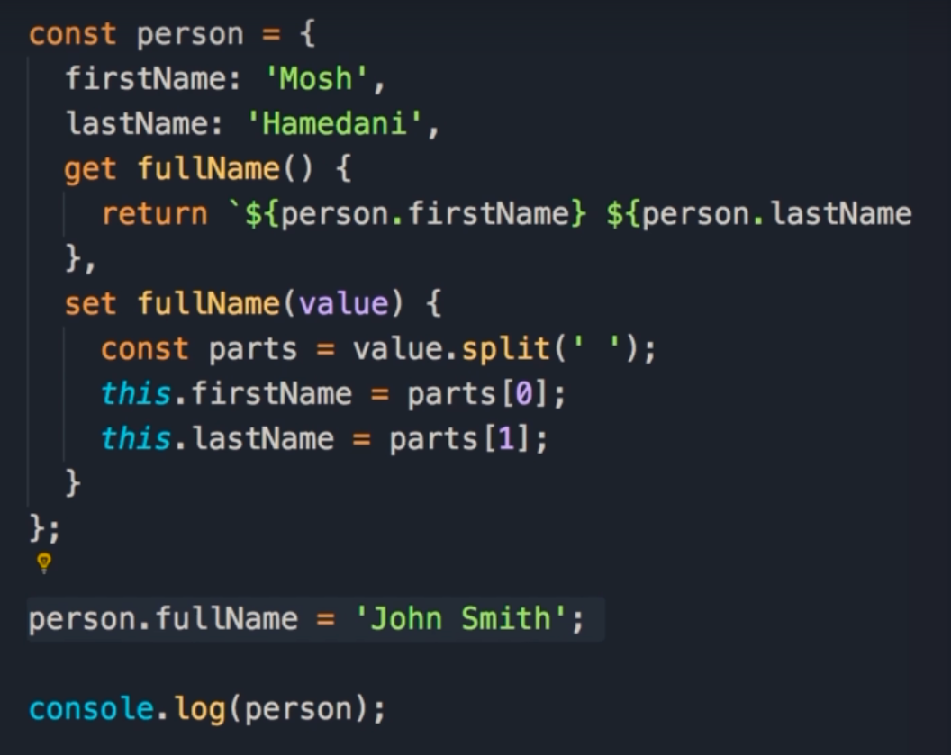
Full Example
Here is the full object, with firstName and lastName properties, as well as fullName getter and setters.
Underneath we use the setter method to change the full name to John Smith.
Let’s take a look what happens when we log the entire person object to the console.
Notes:
But finally, instead of logging the person's full name, let's just log the person object.
So, initially, we set the first and last name to Mosh Hamedani, now with this new property which is actually a setter, for changing the name to John Smith.

Slide 14
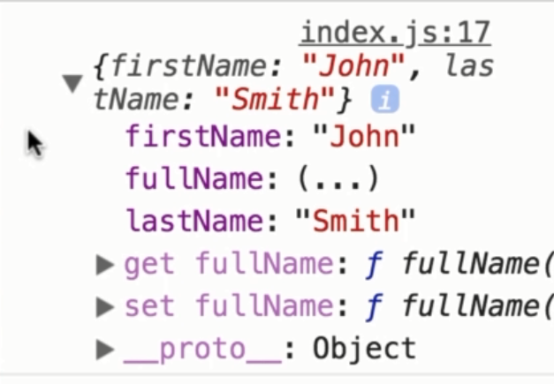
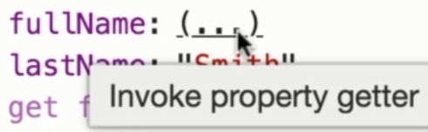
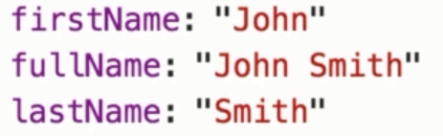
Here we can see that that firstName and lastName properties have been updated.
Also note that the value for fullName is (...)
Sometimes when you log objects to the console, you may see properties with this kind of value.
As you can see from the tooltip, this is a getter.
In order to read the value you need to click here, and now this method is executed and the result is returned in the console.
Notes:
Save the changes, here's our person object, you can see first name and last name properties are updated, also note that full name, it's value is ...
Sometimes when you're logging objects in the console, you may see properties with this kind of value.
As you can see from the tool tip, this is a getter.
In order to read the value you need to click here, and now this method is executed and the result is returned in the console.
So this is the benefit of getters and setters.
In the next lecture we're going to look at error handling.

Slide 15
Final Point
We use getters to access properties in an object, and setters to change or mutate them.

